Slide 1

TO: DANIEL WEBSTER COLLEGE

Slide 2
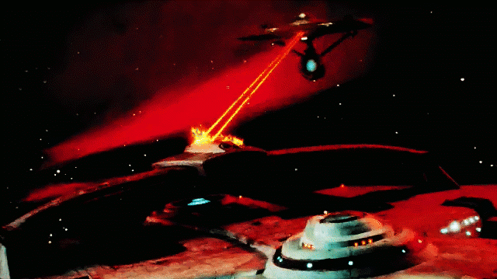
Battle Starships
Proposal by
Chris Amarello
Ryan Flaherty
Jing Ming

Slide 3
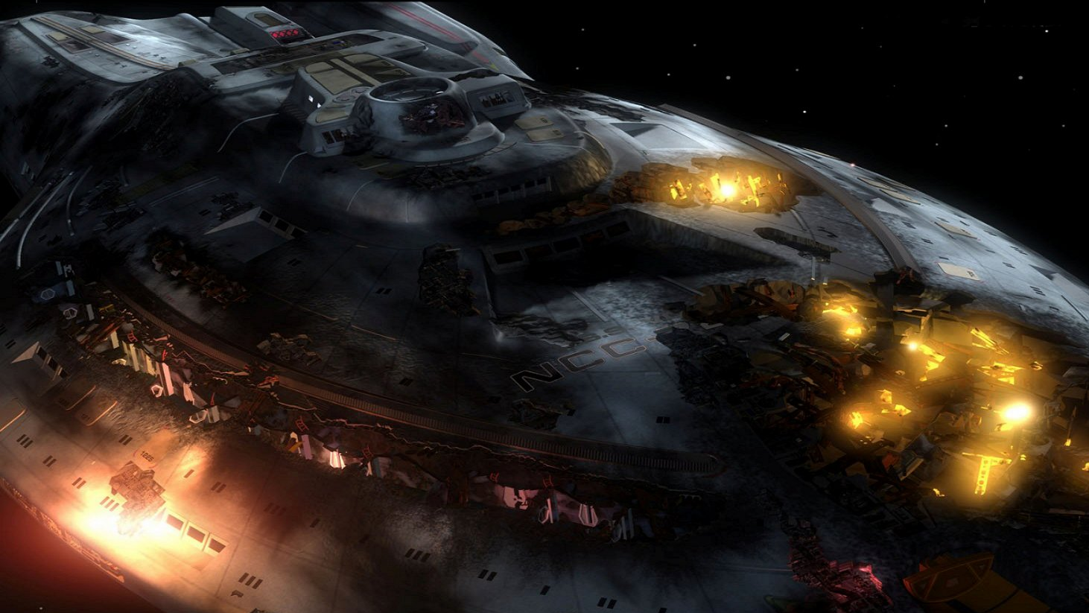
Overview
Roles
Core Mechanics & Rules
Primary Goals (Timeline)
Stretch Goals (Enhancements)

Slide 4
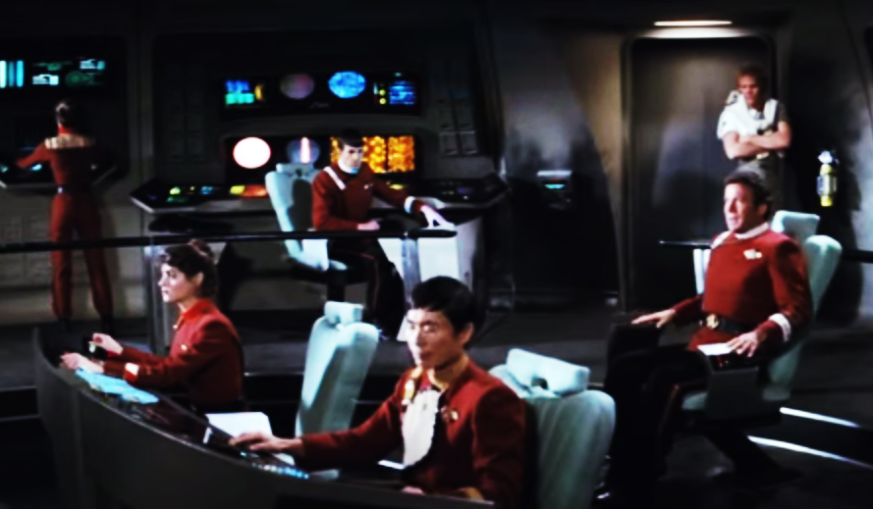
Roles
Chief Programmers
Ryan Flaherty
Jing Mingh
Artistic Programmer
Chris Amarello

Slide 5
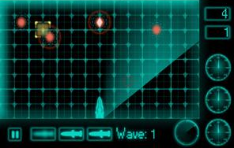
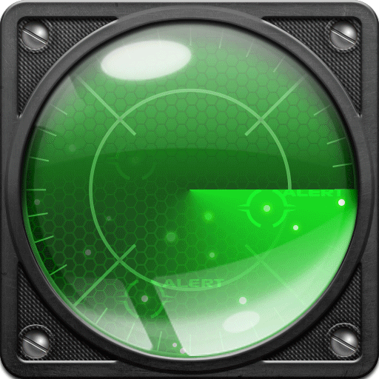
Core Mechanics & Rules
Player Vs. A.I.
Position starship armada on Placement Grid
Fog of War - Unable to see the other player positions
Click on enemy Tactical Grid to fire
Miss – Turn is over
Hit – Damage other enemy ship and turn is over
Win - Destroy the other entire enemy armada
Lose - Your own armada is destroyed!

Slide 6
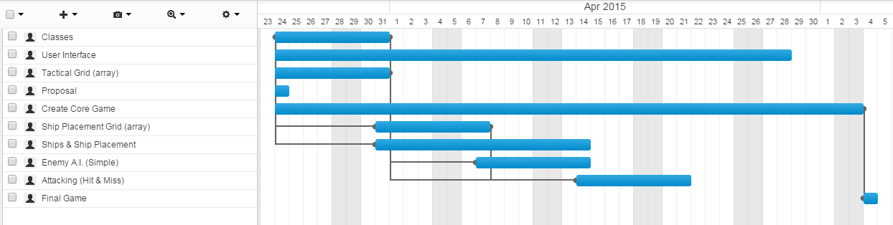
Primary Goals (Timeline)
Create simple base game
Tactical Grid & Ship Placement Grid (array)
Ships & Ship Placement
Attacking (Hit & Miss)
Enemy A.I. (Simple)
User Interface
Classes
Track state of cell on grid (Hit & Miss)
Player

Slide 7
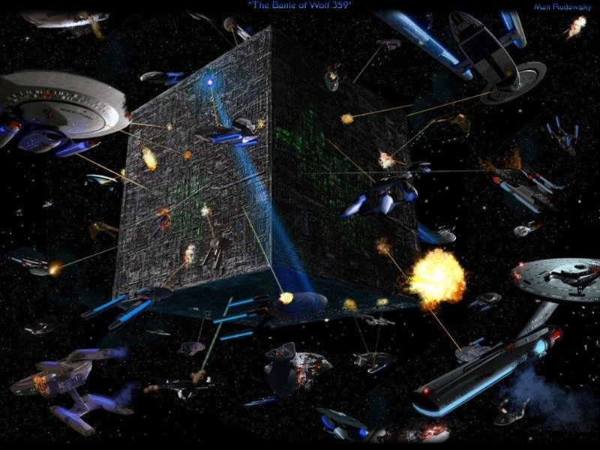
Stretch Goals (Enhancements)
Shield Barriers
AoE attacks (Area of Effect)
Starship repair (Restore HP)
Starfighters
Soundtrack
Starship Movement
Advance A.I. sub-classes

